Slide 1
Lecture 14
More Moore/Mealy machines

Slide 2
Example: Parity checker
Serial input string
  OUT=1 if odd # of 1s in input
  OUT=0 if even # of 1s in input
Let’s do this for Moore and Mealy

Slide 3
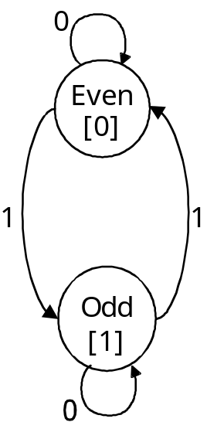
1. State diagram
Moore
Mealy
0/0
1/1
1/0
0/1

Slide 4
2. State transition table
Present Input Next Present
State State Output
Moore
Even 0 Even 0
Even 1 Odd 0
Odd 0 Odd 1
Odd 1 Even 1
Present Input Next Present
State State Output
Mealy
Even 0 Even 0
Even 1 Odd 1
Odd 0 Odd 1
Odd 1 Even 0

Slide 5
3. State minimization
Already minimized
  Need both states (even and odd)
  Use one flip-flop

Slide 6
4. State encoding
Present Input Next Present
State State Output
Assignment
Even 0
Odd 1
Moore
0 0 0 0
0 1 1 0
1 0 1 1
1 1 0 1
Present Input Next Present
State State Output
Mealy
0 0 0 0
0 1 1 1
1 0 1 1
1 1 0 0

Slide 7
5. Next-state logic minimization
Assume D flip-flops
Next state = (present state) XOR (present input)

Slide 8
6. Implement the design
Moore
Mealy
Output
Input
D
Q
Input
D
Q
Output
Current
State
Q
Q
CLK
CLK

Slide 9
Example: Vending machine
Reset
N
Vending
Machine
FSM
Open
Coin
Sensor
Release
Mechanism
D
Clock

Slide 10
Moore machine
Reset
present inputs next present
state D N state output
0¢ 0 0 0¢ 0
0 1 5¢ 0
1 0 10¢ 0
1 1 – –
5¢ 0 0 5¢ 0
0 1 10¢ 0
1 0 15¢ 0
1 1 – –
10¢ 0 0 10¢ 0
0 1 15¢ 0
1 0 15¢ 0
1 1 – –
15¢ – – 15¢ 1
0¢
N
5¢
D
N
D
10¢
N + D
15¢
[open]
symbolic state table

Slide 11
Mealy machine
Reset
present inputs next present
state D N state output
0¢ 0 0 0¢ 0
0 1 5¢ 0
1 0 10¢ 0
1 1 – –
5¢ 0 0 5¢ 0
0 1 10¢ 0
1 0 15¢ 1
1 1 – –
10¢ 0 0 10¢ 0
0 1 15¢ 1
1 0 15¢ 1
1 1 – –
15¢ – – 15¢ 1
0¢
N/0
5¢
D/0
N/0
D/1
10¢
N + D/1
15¢
symbolic state table

Slide 12
Moore machine: State encoding
present inputs next present
state D N state output
0¢ 0 0 0¢ 0
0 1 5¢ 0
1 0 10¢ 0
1 1 – –
5¢ 0 0 5¢ 0
0 1 10¢ 0
1 0 15¢ 0
1 1 – –
10¢ 0 0 10¢ 0
0 1 15¢ 0
1 0 15¢ 0
1 1 – –
15¢ – – 15¢ 1
present state inputs next state present
Q1 Q0 D N D1 D0 output
0 0 0 0 0 0 0
0 1 0 1 0
1 0 1 0 0
1 1 – – –
0 1 0 0 0 1 0
0 1 1 0 0
1 0 1 1 0
1 1 – – –
1 0 0 0 1 0 0
0 1 1 1 0
1 0 1 1 0
1 1 – – –
1 1 – – 1 1 1
symbolic state table

Slide 13
Mealy machine: State encoding
present inputs next present
state D N state output
0¢ 0 0 0¢ 0
0 1 5¢ 0
1 0 10¢ 0
1 1 – –
5¢ 0 0 5¢ 0
0 1 10¢ 0
1 0 15¢ 1
1 1 – –
10¢ 0 0 10¢ 0
0 1 15¢ 1
1 0 15¢ 1
1 1 – –
15¢ – – 15¢ 1
present state inputs next state present
Q1 Q0 D N D1 D0 output
0 0 0 0 0 0 0
0 1 0 1 0
1 0 1 0 0
1 1 – – –
0 1 0 0 0 1 0
0 1 1 0 0
1 0 1 1 1
1 1 – – –
1 0 0 0 1 0 0
0 1 1 1 1
1 0 1 1 1
1 1 – – –
1 1 – – 1 1 1
symbolic state table

Slide 14
Logic minimization
Moore
Q1
Q1
Q1
D1
D0
Open
0 0 1 1
0 1 1 1
X X X X
1 1 1 1
0 1 1 0
1 0 1 1
X X X X
0 1 1 1
0 0 1 0
0 0 1 0
X X 1 X
0 0 1 0
N
N
N
D
D
D
Q0
Q0
Q0
Mealy
D1
Q1
Q1
Q1
D0
Open
0 0 1 1
0 1 1 1
X X X X
1 1 1 1
0 1 1 0
1 0 1 1
X X X X
0 1 1 1
0 0 1 0
0 0 1 1
X X 1 X
0 1 1 1
N
N
N
D
D
D
Q0
Q0
Q0

Slide 15
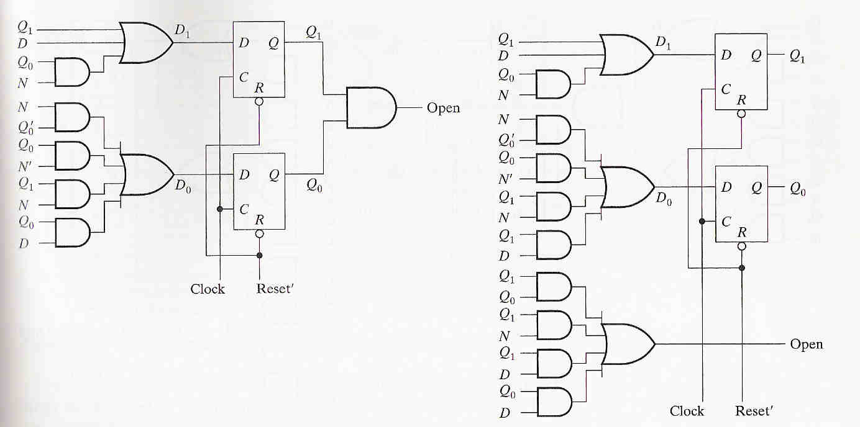
Implementation
Moore
Mealy

Slide 16
7.24
A Moore machine has two inputs (X1, X2) and one output (Z). The output remains a constant value unless one of the following input sequence occurs:
  The input sequence 00,11 causes the output to become 0.
  The input sequence 01,11 causes the output to become 1.
  The input sequence 10,11 causes the output to toggle value.

Slide 17
7.23
A Mealy machine has one input (X) and two outputs (Z1 and Z2). An output Z1 = 1 occurs every time the input sequence 101 is observed, provided the sequence 011 has never been seen. An output Z2 = 1 occurs every time the input 011 is observed.

